Slide 1
Chapter 1 The Foundations : Logic and Proofs Kenneth H. Rosen 7th edition
Section 1.7 :Introduction to Proofs

Slide 2
Some Terminologies
Theorem:
A statement that can be shown to be true.
Usually reserved for a statement that is considered at least somewhat important.
Less important theorems sometimes are called Propositions.
Proof:
Used to demonstrate that a theorem is true.
A valid argument that establishes the truth of a theorem.

Slide 3
Some Terminologies(Contd.)
Axioms:
Statements that are assumed to be true.
May be stated using primitive terms that do not require deﬁnition.
Lemma:
A less important theorem that is helpful in the proof of other results .
Corollary:
A theorem that can be established directly from a theorem that has been proved.

Slide 4
Some Terminologies(Contd.)
Conjecture:
A statement that is being proposed to be a true statement, usually on the basis of
Some partial evidence Or,
A heuristic argument Or,
The intuition of an expert
When a proof of a conjecture is found, the conjecture becomes a theorem.
Many times conjectures are shown to be false, so they are not theorems.

Slide 5
Methods of Proving Theorems
Direct Proofs
Proof by Contraposition
Vacuous and Trivial Proofs
Proof by Contradiction

Slide 6
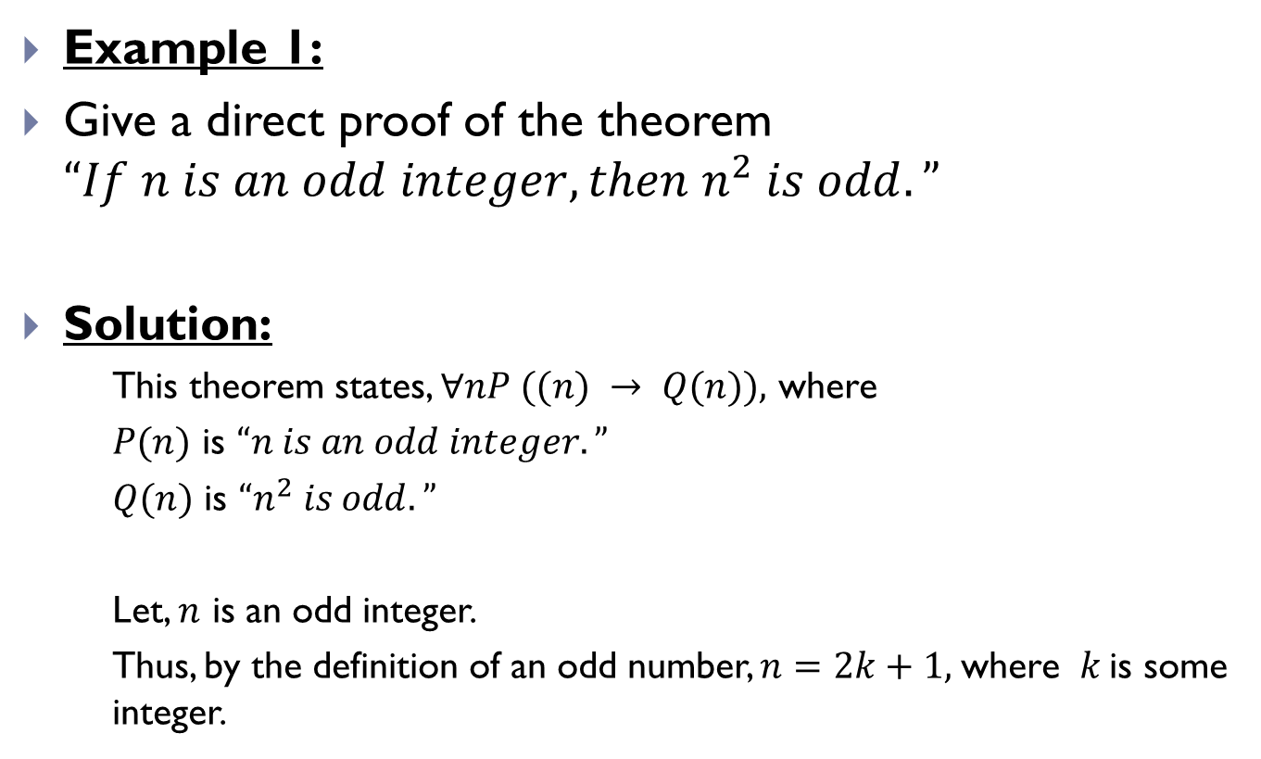
Direct Proof
Example 1:
Give a direct proof of the theorem $“If n is an odd integer, then n^{2} is odd.”$
Solution:
This theorem states, $∀nP ((n) → Q(n)),$ where
$P(n)$ is $“n is an odd integer.”$
$Q(n)$ is $“n^{2} is odd.”$
Let, $n$ is an odd integer.
Thus, by the definition of an odd number, $n=2k+1,$where $k$is some integer.

Slide 7
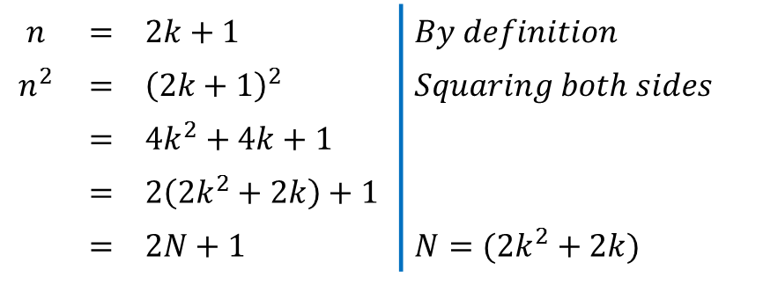

Direct Proof(Contd.)
Thus, we can write,
Thus from the above deduction, we can see that $n^{2}$ is also an odd number by the definition of odd number.
Thus, we can say that, $"If n is an odd integer, then n^{2} is odd.”$
$$n$$ | $$=$$ | $2k+1$ | $By definition$
$$n^{2}$$ | $$=$$ | ${\left(2k+1\right)}^{2}$ | $Squaring both sides$
 | $$=$$ | $4k^{2}+4k+1$
 | $$=$$ | $2\left(2k^{2}+2k\right)+1$
 | $$=$$ | $2N+1$ | $N=(2k^{2}+2k)$

Slide 8
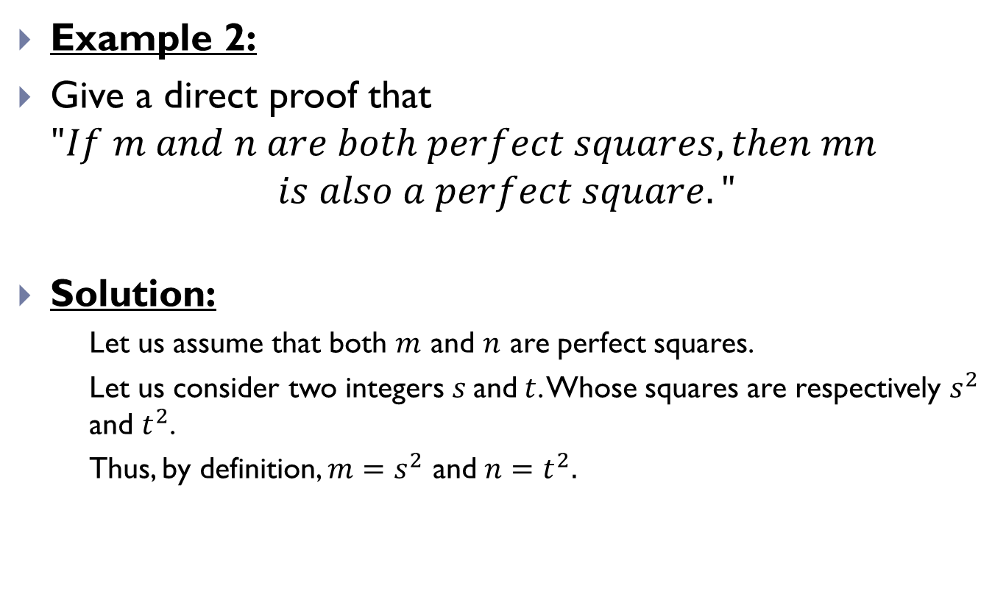
Direct Proof(Contd.)
Example 2:
Give a direct proof that $"If m and n are both perfect squares, then mn$
$$is also a perfect square."$$
Solution:
Let us assume that both $m$ and $n$ are perfect squares.
Let us consider two integers $s$and$t$. Whose squares are respectively $s^{2}$ and $t^{2}$.
Thus, by definition, $m=s^{2}$ and $n=t^{2}.$

Slide 9
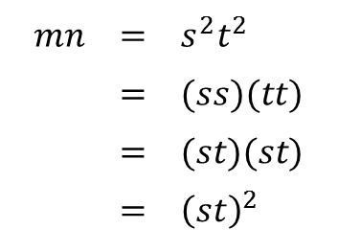

Direct Proof(Contd.)
Thus,
Thus, by definition, $mn$ is also a perfect square.
Thus, we can say that,
"𝐼𝑓 𝑚 𝑎𝑛𝑑 𝑛 𝑎𝑟𝑒 𝑏𝑜𝑡ℎ 𝑝𝑒𝑟𝑓𝑒𝑐𝑡 𝑠𝑞𝑢𝑎𝑟𝑒𝑠, 𝑡ℎ𝑒𝑛 𝑚𝑛
𝑖𝑠 𝑎𝑙𝑠𝑜 𝑎 𝑝𝑒𝑟𝑓𝑒𝑐𝑡 𝑠𝑞𝑢𝑎𝑟𝑒."
$mn$ | $$=$$ | $s^{2}t^{2}$
 | $$=$$ | $(ss)(tt)$
 | $$=$$ | $(st)(st)$
 | $$=$$ | ${\left(st\right)}^{2}$

Slide 10
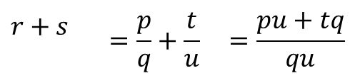
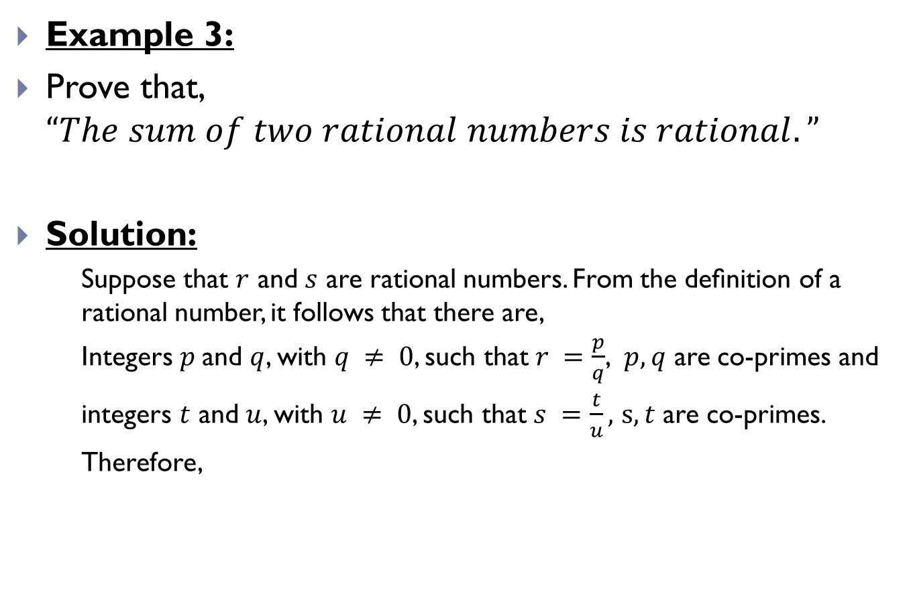
Direct Proof(Contd.)
Example 3:
Prove that, $“The sum of two rational numbers is rational.”$
Solution:
Suppose that $r$ and $s$ are rational numbers. From the deﬁnition of a rational number, it follows that there are,
Integers $p$and $q$, with $q ≠ 0$, such that $r =\frac{p}{q}$, $p,q$ are co-primes and
integers $t$ and $u$, with $u ≠ 0$, such that $s =\frac{t}{u},$ $s,t$ are co-primes.
Therefore,
$r+s$ | $$=\frac{p}{q}+\frac{t}{u}$$ | $$=\frac{pu+tq}{qu}$$

Slide 11

Direct Proof(Contd.)
Because $q≠0$ and $u≠0$, it follows that, $qu≠0$
Consequently, we have expressed $r + s$as the ratio of two integers, $pu +qt$and $qu$, where $qu≠0$. This means that $r + s$is rational.
Thus, we can say that, $“The sum of two rational numbers is rational.”$

Slide 12
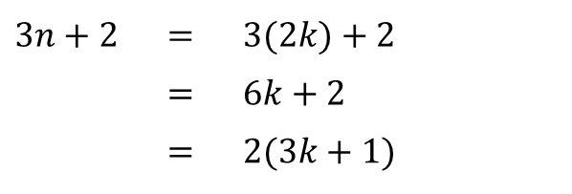
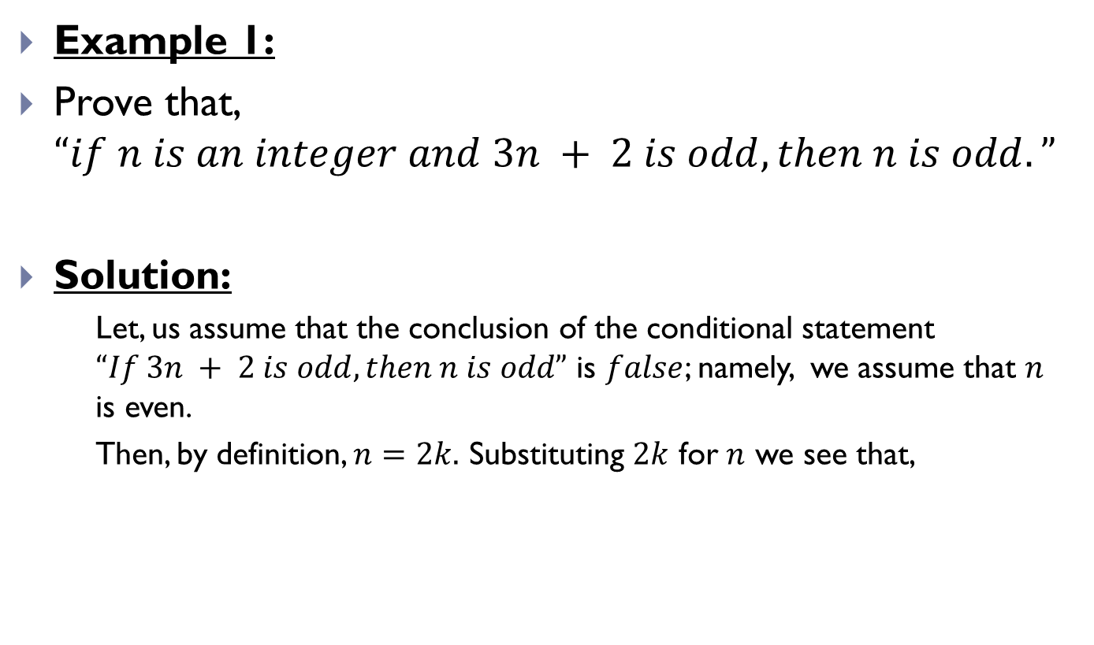
Proof by Contraposition
Example 1:
Prove that, $“if n is an integer and 3n + 2 is odd, then n is odd.”$
Solution:
Let, us assume that the conclusion of the conditional statement $“If 3n + 2 is odd, then n is odd”$ is $false$; namely, we assume that $n$ is even.
Then, by definition, $n=2k.$ Substituting $2k$ for $n$ we see that,
$3n+2$ | $=$ | $3(2k)+2$
 | $=$ | $6k+2$
 | $=$ | $2(3k+1)$

Slide 13

Proof by Contraposition(Contd.)
This tells us that $3n + 2$is even (because it is a multiple of 2), and therefore not odd.
This is the negation of the premise of the theorem.
Because the negation of the conclusion of the conditional statement implies that the hypothesis is false, the original conditional statement is true. Our proof by contraposition succeeded;
We have proved the theorem $“If 3n + 2 is odd, then n is odd.”$

Slide 14
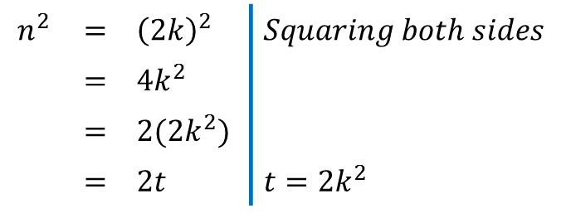
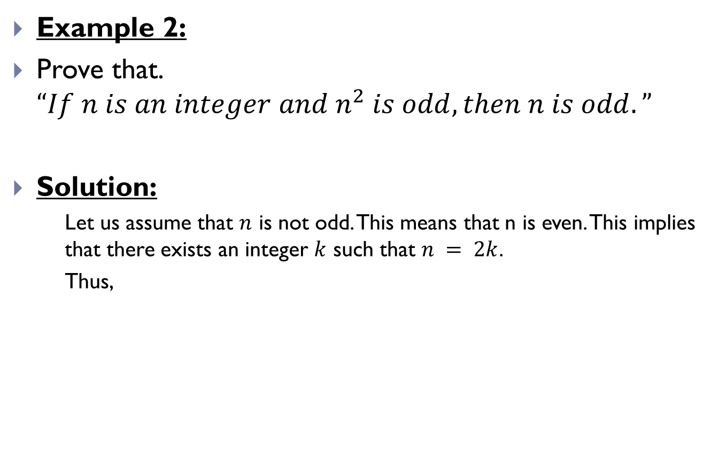
Proof by Contraposition(Contd.)
Example 2:
Prove that. $“If n is an integer and n^{2} is odd, then n is odd.”$
Solution:
Let us assume that $n$ is not odd. This means that n is even. This implies that there exists an integer $k$ such that $n = 2k$.
Thus,
$$n^{2}$$ | $$=$$ | ${\left(2k\right)}^{2}$ | $Squaring both sides$
 | $$=$$ | $4k^{2}$
 | $$=$$ | $2(2k^{2})$
 | $$=$$ | $2t$ | $t=2k^{2}$

Slide 15

Proof by Contraposition(Contd.)
Which implies that $n^{2}$ is also even.
We have proved that, $"If n is an integer and n^{2} is odd, then n$
$is odd.“$ by contraposition.

Slide 16
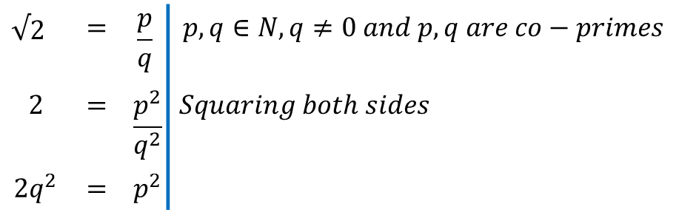

Proof by Contradiction
Example 1:
Prove that $"√2 is irrational"$.
Solution:
Let, $s=$ $"√2 is irrational"$
$∴¬s="√2 is rational.“$
If $¬s$ is true then,
$√2$ | $$=$$ | $$\frac{p}{q}$$ | $$p,q∈N, q≠0 and p,q are co−primes$$
$$2$$ | $$=$$ | $$\frac{p^{2}}{q^{2}}$$ | $Squaring both sides$
$$2q^{2}$$ | $$=$$ | $$p^{2}$$

Slide 17
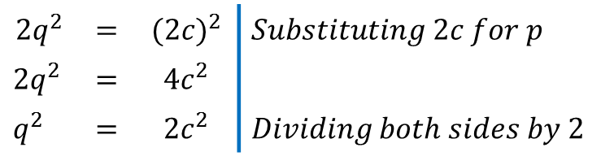
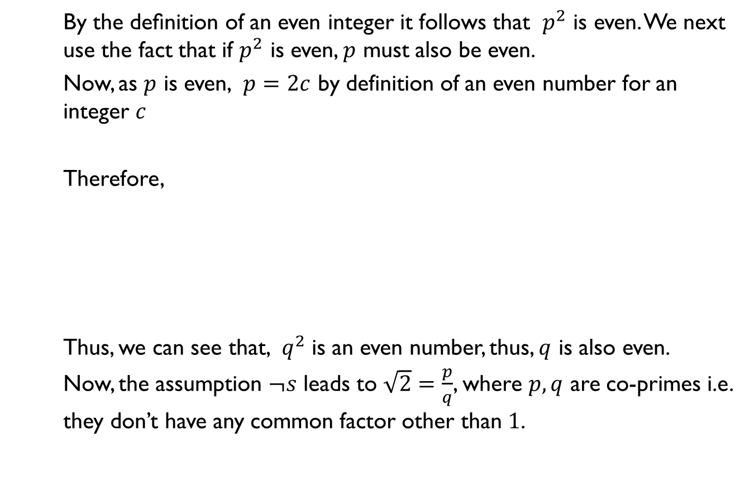
Proof by Contradiction(Contd.)
By the deﬁnition of an even integer it follows that $p^{2}$ is even. We next use the fact that if $p^{2}$ is even, $p$ must also be even.
Now, as $p$ is even, $p=2c$ by definition of an even number for an integer $c$
Therefore,
Thus, we can see that, $q^{2}$ is an even number, thus, $q$ is also even.
Now, the assumption $¬s$ leads to $\sqrt{2}=\frac{p}{q}$, where $p,q$ are co-primes i.e. they don’t have any common factor other than $1$.
$$2q^{2}$$ | $$=$$ | $${(2c)}^{2}$$ | $Substituting 2c for p$
$$2q^{2}$$ | $$=$$ | $$4c^{2}$$
$q^{2}$ | $$=$$ | $$2c^{2}$$ | $Dividing both sides by 2$

Slide 18

Proof by Contradiction(Contd.)
But, we can see that, $p,q$ both are even and both are divisible by $2.$
Thus, we can see that, our assumption $¬s$ leads to a contradiction.
Therefore, $¬s$ must be $false,$ that is $s$ is $true.$
Therefore, $"√2 is irrational."$

Slide 19
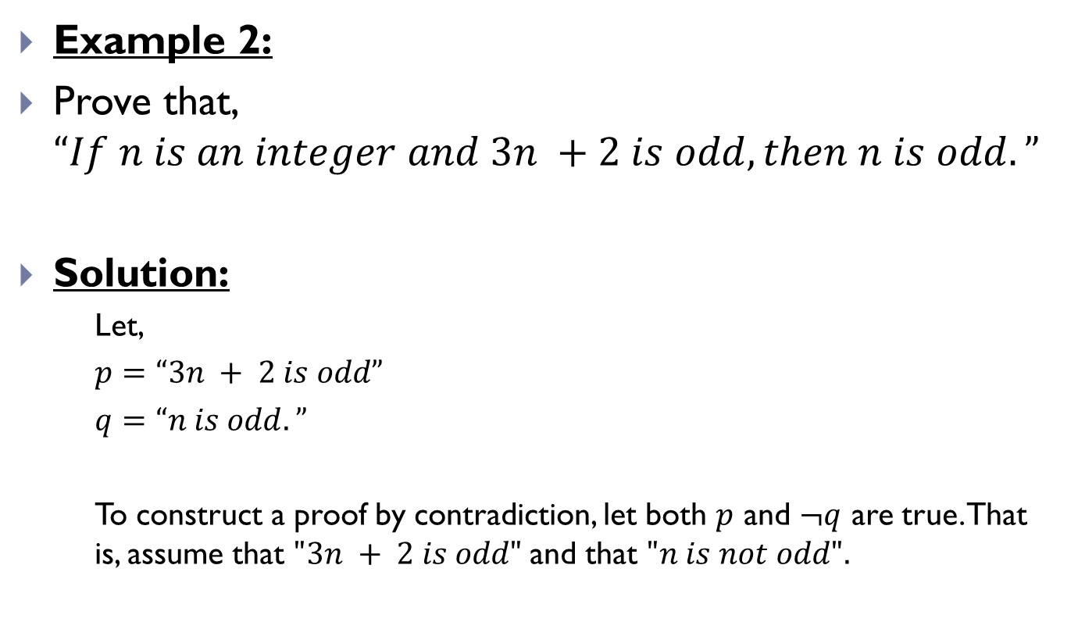
Proof by Contradiction(Contd.)
Example 2:
Prove that, $“If n is an integer and 3n +2 is odd, then n is odd.”$
Solution:
Let,
$p=“3n + 2 is odd”$
$q=“n is odd.”$
To construct a proof by contradiction, let both $p$ and $¬q$ are true. That is, assume that $"3n + 2 is odd"$and that $"n is not odd".$

Slide 20
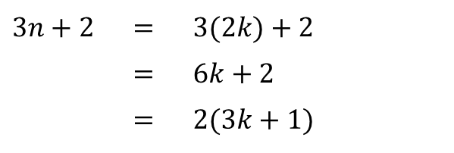
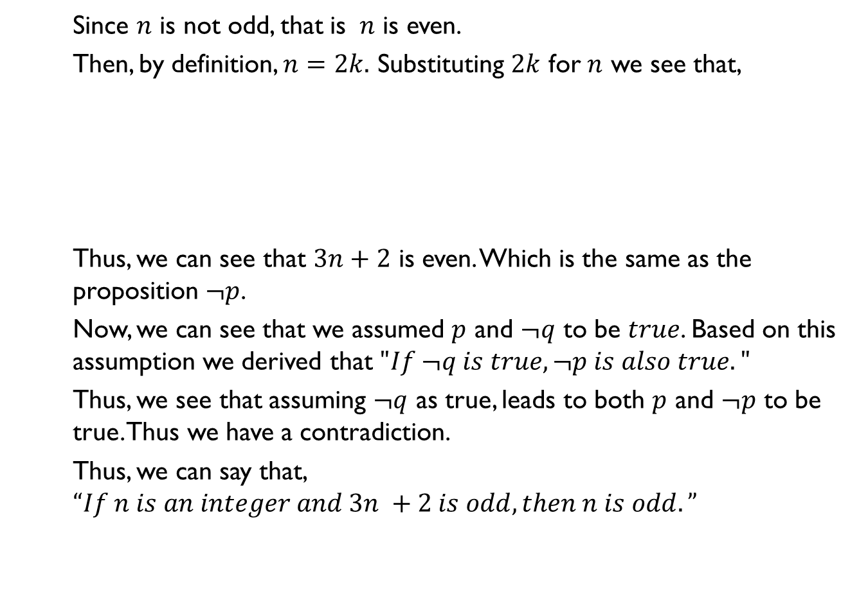
Proof by Contradiction(Contd.)
Since $n$ is not odd, that is $n$ is even.
Then, by definition, $n=2k.$ Substituting $2k$ for $n$ we see that,
Thus, we can see that $3n+2$ is even. Which is the same as the proposition $¬p$.
Now, we can see that we assumed $p$ and $¬q$ to be $true$. Based on this assumption we derived that $"If ¬q is true, ¬p is also true."$
Thus, we see that assuming $¬q$ as true, leads to both $p$ and $¬p$ to be true. Thus we have a contradiction.
Thus, we can say that, $“If n is an integer and 3n +2 is odd, then n is odd.”$
$3n+2$ | $=$ | $3(2k)+2$
 | $=$ | $6k+2$
 | $=$ | $2(3k+1)$

Slide 21
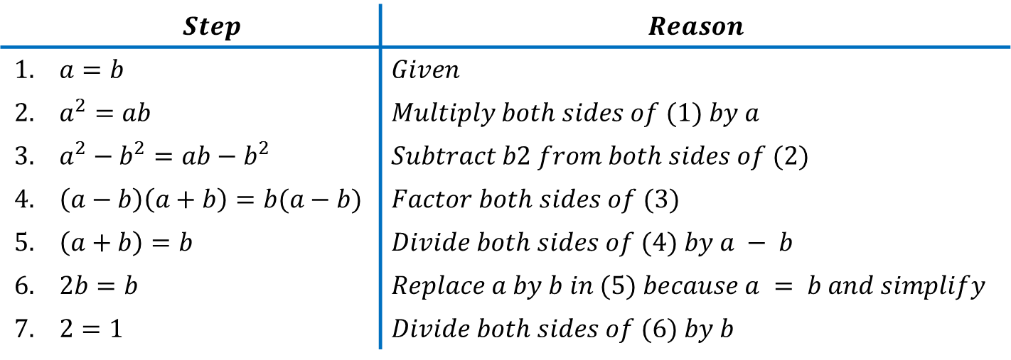

Mistakes in Proofs
Example 1:
What is wrong with this “proof” that $1 = 2$?
“Proof:" We use these steps, where a and b are two equal positive integers.
 | $$Step$$ | $$Reason$$
$$1.$$ | $a=b$ | $Given$
$$2.$$ | $a^{2}=ab$ | $Multiply both sides of (1) by a$
$$3.$$ | $a^{2}−b^{2}=ab−b^{2}$ | $Subtract b2 from both sides of (2)$
$$4.$$ | $\left(a−b\right)\left(a+b\right)=b(a−b)$ | $Factor both sides of (3)$
$$5.$$ | $\left(a+b\right)=b$ | $Divide both sides of (4) by a − b$
$$6.$$ | $2b=b$ | $Replace a by b in (5) because a = b and simplify$
$$7.$$ | $2=1$ | $Divide both sides of (6) by b$

Slide 22

Mistakes in Proofs(Contd.)
Solution:
Every step is valid except for one, $step 5$ where we divided both sides by $\left(a − b\right).$ The error is that $\left(a − b\right)$ equals zero; division of both sides of an equation by the same quantity is valid as long as this quantity is not zero.

Slide 23
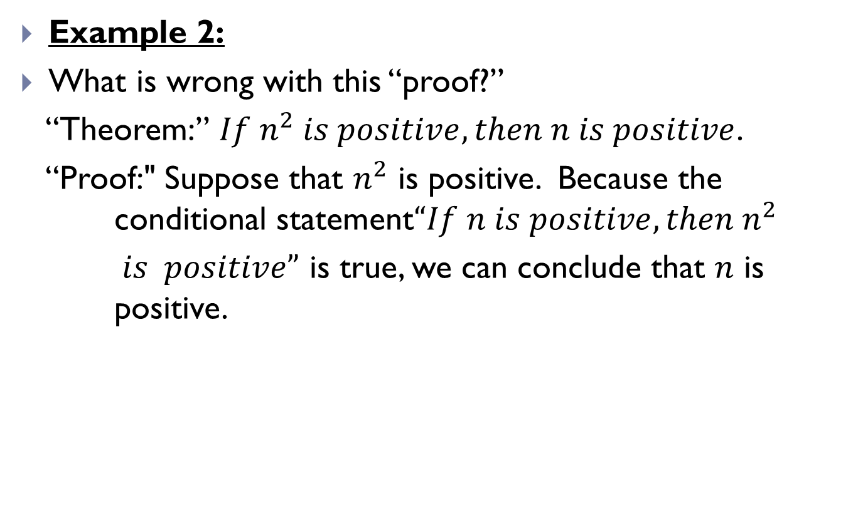
Mistakes in Proofs(Contd.)
Example 2:
What is wrong with this “proof?”
“Theorem:” $If n^{2} is positive, then n is positive$.
“Proof:" Suppose that $n^{2}$ is positive. Because the conditional statement$“If n is positive, then n^{2}$
$is positive”$ is true, we can conclude that $n$ is positive.

Slide 24
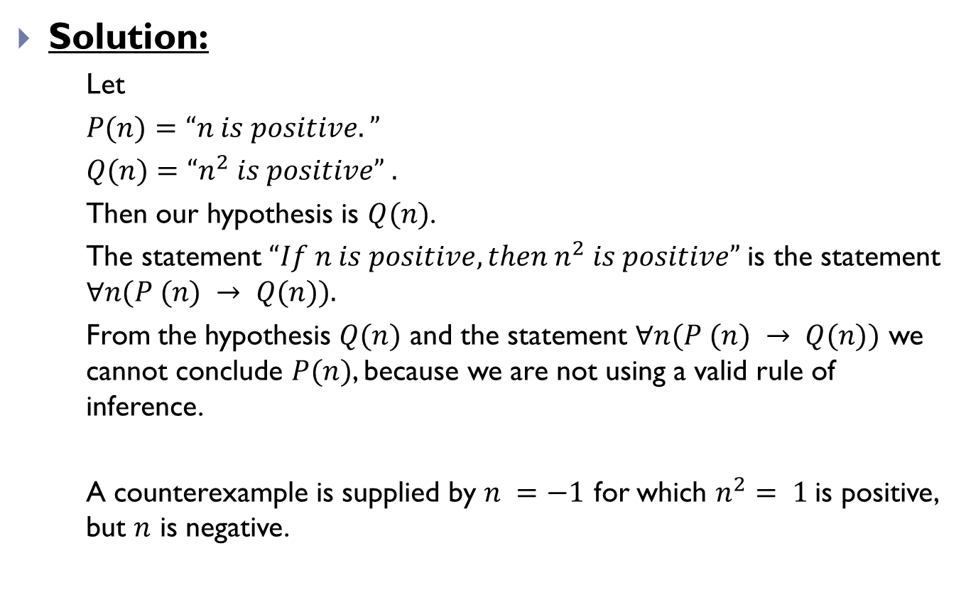
Mistakes in Proofs(Contd.)
Solution:
Let
$P(n)=“n is positive.”$
$Q(n)=“n^{2} is positive” .$
Then our hypothesis is $Q(n)$.
The statement $“If n is positive, then n^{2} is positive”$is the statement $∀n(P (n) → Q(n)).$
From the hypothesis $Q(n)$ and the statement $∀n(P (n) → Q(n))$ we cannot conclude $P(n)$, because we are not using a valid rule of inference.
A counterexample is supplied by $n =−1$ for which $n^{2}= 1$is positive, but $n$ is negative.

Slide 25
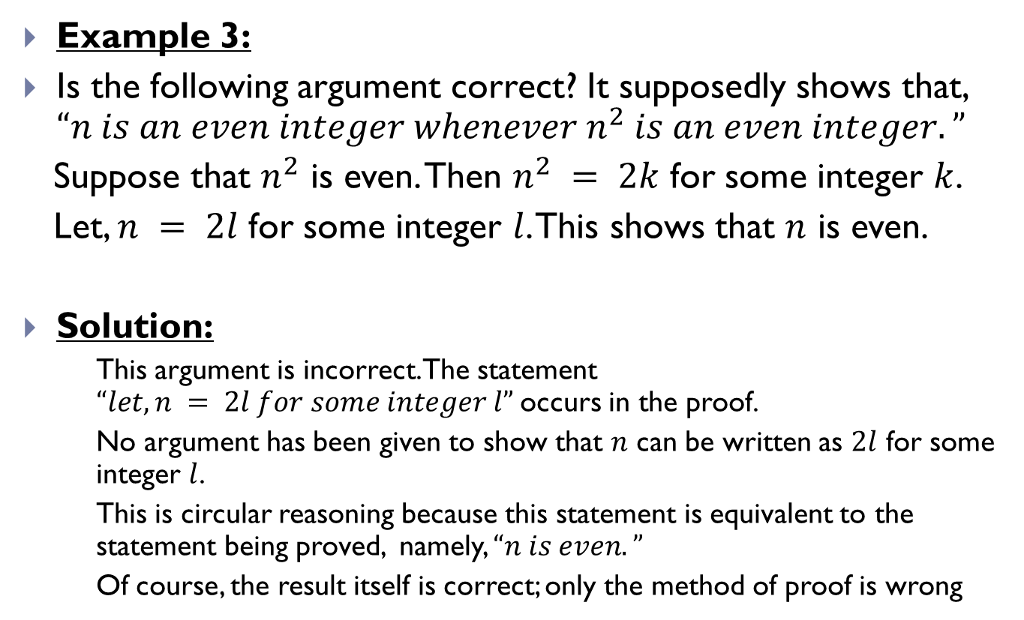
Mistakes in Proofs(Contd.)
Example 3:
Is the following argument correct? It supposedly shows that, $“n is an even integer whenever n^{2} is an even integer.”$
Suppose that $n^{2}$ is even. Then $n^{2} = 2k$ for some integer $k$.
Let, $n = 2l$ for some integer $l$. This shows that $n$ is even.
Solution:
This argument is incorrect. The statement $“let, n = 2l for some integer l”$occurs in the proof.
No argument has been given to show that $n$ can be written as $2l$ for some integer $l$.
This is circular reasoning because this statement is equivalent to the statement being proved, namely, $“n is even.”$
Of course, the result itself is correct; only the method of proof is wrong

Slide 26
THE END

